Slide 1
POV, HMW, Experience Prototypes
CS147: Assignment #2
Matthew Mattei, Alison Rogers, Justin Blumencranz, Monica Hicks

Slide 2
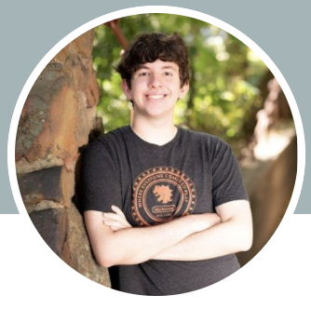
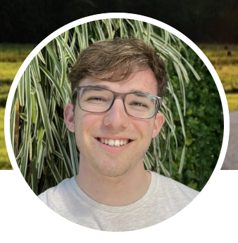
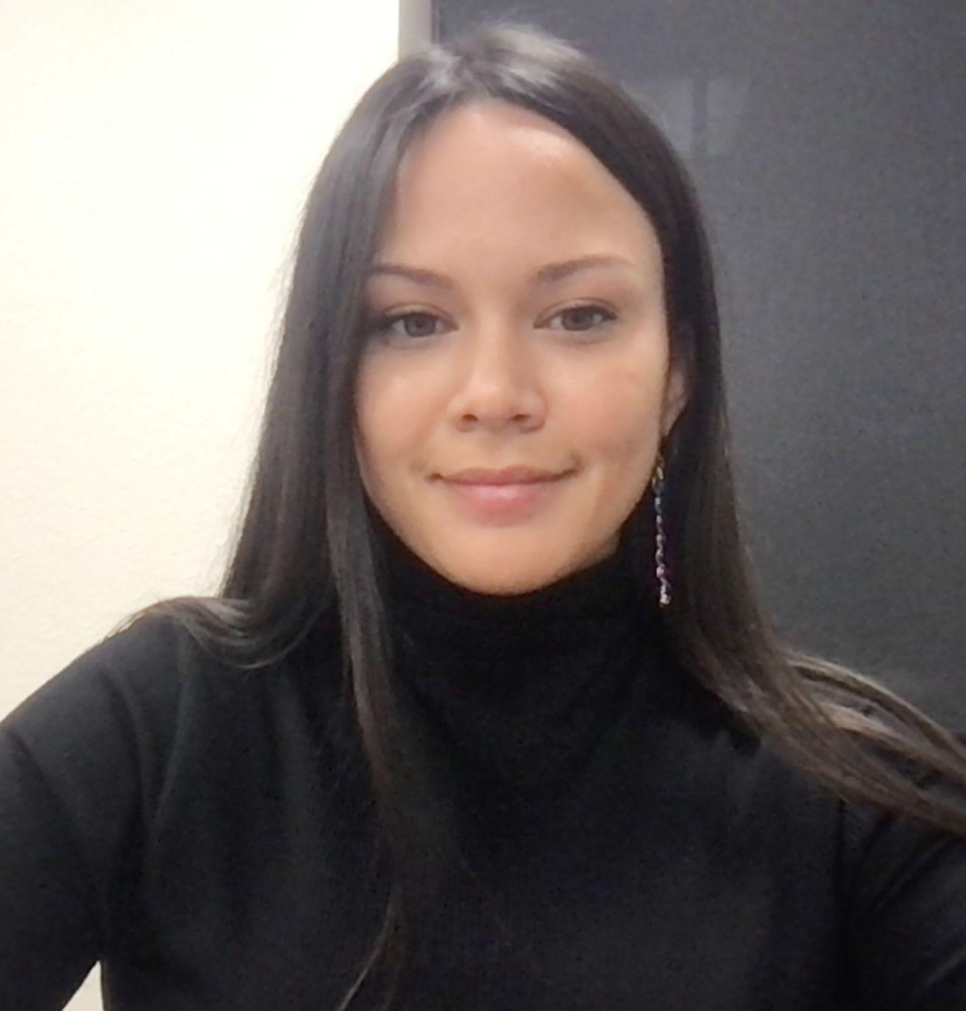
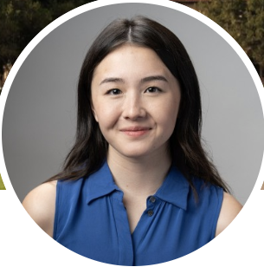
The Glue Crew
Matthew Mattei
Justin
Blumencranz
Alison
Rogers
Monica Hicks

Slide 3

Original Problem Domain
High School Students

Slide 4
Narrowed Domain
Connecting
High School
Students

Slide 5
01
Additional
Needfinding

Slide 6
Ryder
Type: High School Sophomore
Location: His house in Menlo Park
Interviewer: Monica
Reason for Selection: Local high school athlete who is just beginning to seriously think about college.
Key Findings:
❏ A - Takes group notes simultaneously in a shared Google Doc with three friends. Ensures note quality and gives them room to have a “bad day” in class.
❏ B - His middle school had a college counselor, and he was able to meet with them and ensure he was on track with college aspirations as early as 6th grade.
❏ C - Was peer-pressured into taking harder classes this year and rearranged his schedule after the first week of term.

Slide 7
Sue
Type: Education Admissions Consultant
Location: Zoom
Interviewers: Alison
Reason for Selection: Has worked in admissions and college counseling; deep empathy & understanding of college prep and crafting college applications; FLI.
Key Findings:
❏ “There’s a lot higher stakes earlier on.”
❏ Admissions offices don’t see FLI applications as impressive compared to non-FLI applications because FLI applications aren’t as “packaged and shiny.”
❏ “I think it takes a lot of level of maturity to want to be intellectually engaged”

Slide 8
Key Learnings
Ryder:
Despite having access to college counselors as early as 11, students can be left scrambling at 15 to enroll in appropriate classes and make progress towards their academic goals.
Despite having access to slideshows and teacher notes, students prefer to work jointly on note taking to ensure quality and pool their collective knowledge.
Peers can serve as the best source of academic benchmarking and goal setting for students uncertain of their academic aspirations.
Sue:
Schools and teachers are not deeply engaged with children’s different needs, especially around disabilities
College admissions offices do not understand the stories behind FLI students and the work that their applications are evidence of
Kids are less engaged with their education because of AI, and it can disproportionately benefit already privileged students

Slide 9
02
POVs,
HMWs

Slide 10
Initial POV
We met | Jerry, a diving Paly high schooler committed to College.
We were surprised to learn | that, despite falling out love with diving, he does it for 2.5 hours each day, except weekends.
We wonder if this means | that he’s afraid of losing opportunities.
It would be game-changing to | offer more pressure-free opportunities to explore his future

Slide 11
Initial POV
We met | Jerry, a diving Paly high schooler committed to College.
We were surprised to learn | that, despite falling out love with diving, he does it for 2.5 hours each day, except weekends.
We wonder if this means | that he’s afraid of losing opportunities.
It would be game-changing to | offer more pressure-free opportunities to explore his future
phrasing not quite relevant

Slide 12
Initial POV
We met | Jerry, a diving Paly high schooler committed to College.
We were surprised to learn | that, despite falling out love with diving, he does it for 2.5 hours each day, except weekends.
We wonder if this means | that he’s afraid of losing opportunities.
It would be game-changing to | offer more pressure-free opportunities to explore his future
phrasing not quite relevant
way too broad

Slide 13
Initial POV
We met | Jerry, a diving Paly high schooler committed to College.
We were surprised to learn | that, despite falling out love with diving, he does it for 2.5 hours each day, except weekends.
We wonder if this means | that he’s afraid of losing opportunities.
It would be game-changing to | offer more pressure-free opportunities to explore his future
phrasing not quite relevant
way too broad
There has to be a better focal point

Slide 14
02.1
POVs,
HMWs

Slide 15
Revised Jerry POV
We met | Jerry, a Paly high school diver uncertain about his future at college.
We were surprised to note | that he dives 2.5 hours every weekday despite having lost his passion for the sport.
We wonder if this means | that he is afraid to explore new hobbies and activities if they came at the potential expense of existing skills.
It would be game-changing | for him to have low-commitment opportunities to shop new activities in a flexible manner.

Slide 16
Now we have a foundation for making incisive POVs
and we’re finding some strong signal that connecting to yourself and others are threads worth pulling.

Slide 17
Sasha POV
We met | Sasha, a high schooler coaching volleyball obsessed with academic success.
We were surprised to notice | that she no longer plays volleyball, despite enjoying it, in favor of a coaching job that looks better on her college application.
We wonder if this means | she believes sacrificing her high school enjoyment is necessary for a secure future.
It would be game-changing to | convince Sasha that she can pursue her genuine passions and set herself up for success.
Notes:
Use Sasha’s drive and ambition to make time for personal activities?
Make personal hobbies feel as important as “resume activities”?
Stop Sasha from sacrificing hobbies she enjoys?
Enable Sasha to explore new potentially impressive activities she may enjoy more?
Boost Sasha’s college readiness in a fun/low stress environment?
Convince Sasha to explore non traditional post-graduation options?
Make the process of preparing for college like a scavenger hunt?
Make her love coaching as much as she loves playing?
Find more passion/enjoyment in the “impressive” resume items?
Redefine Sasha’s definition of success?
Show her how “good” her application already is?
Remove the pressure to “spend 100% of your time” getting into college?
Make fun AND impactful opportunities more available?
Make pursuing achievements exciting rather than stressful?
Make curating a college app like therapy/like a bucket list?
Provide more clarity/guidance around what admissions is looking for in a “holistic” application?

Slide 18
Sasha POV
HMW make curating a college app like therapy?
We met | Sasha, a high schooler coaching volleyball obsessed with academic success.
We were surprised to notice | that she no longer plays volleyball, despite enjoying it, in favor of a coaching job that looks better on her college application.
We wonder if this means | she believes sacrificing her high school enjoyment is necessary for a secure future.
It would be game-changing to | convince Sasha that she can pursue her genuine passions and set herself up for success.

Slide 19
Sasha POV
HMW make curating a college app like a bucket list?
We met | Sasha, a high schooler coaching volleyball obsessed with academic success.
We were surprised to notice | that she no longer plays volleyball, despite enjoying it, in favor of a coaching job that looks better on her college application.
We wonder if this means | she believes sacrificing her high school enjoyment is necessary for a secure future.
It would be game-changing to | convince Sasha that she can pursue her genuine passions and set herself up for success.

Slide 20
Ryder POV
We met | Ryder, a high school student who combines digital group notes with friends to guarantee note quality.
We were surprised to notice | that he doesn’t combine notes with other students in his hardest subject, math, where he prefers to write his notes on paper.
We wonder if | he distrusts the quality and accessibility of other students’ notes when they aren’t made collaboratively.
It would be game-changing to | enable Ryder to feel confident in his peers’ notes, even when made independently, lessening his personal note-taking burden.
Notes:
Improve online math notes?
Make an efficient note-taking system that can generalize to any class?
Make combining handwritten notes cleaner and faster?
Enhance student notes with resources outside the classroom?
Involve the teacher in the notetaking process?
Remove the need for group notes? Make notes obsolete?
Make taking notes like a team project?
Make taking notes more enjoyable?
Make notetaking a contest/competition?
Make handwriting notes more efficient?
Make collaborating on handwritten notes relaxing?

Slide 21
Ryder POV
HMW make combining handwritten notes cleaner and faster?
We met | Ryder, a high school student who combines typed group notes with friends to guarantee note quality.
We were surprised to notice | that he doesn’t use this method in his hardest subject, math, because he prefers to hand write his notes.
We wonder if | he believes it is too complicated to collaborate on handwritten notes.
It would be game-changing to | ensure Ryder can feel secure in his access to consistent and reliable notes after every class.
We met | Ryder, a high school student who combines digital group notes with friends to guarantee note quality.
We were surprised to notice | that he doesn’t combine notes with other students in his hardest subject, math, where he prefers to write his notes on paper.
We wonder if | he distrusts the quality and accessibility of other students’ notes when they aren’t made collaboratively.
It would be game-changing to | enable Ryder to feel confident in his peers’ notes, even when made independently, lessening his personal note-taking burden.

Slide 22
Anwar POV
We met | Anwar, a Bay Area student trying to transfer out of a virtual high school that only cares about attendance.
We were surprised to notice | that his classes are so poorly timed that he has to hand write his schedule and set numerous alarms to make his classes.
We wonder if this means | he feels unsupported by his school’s admin and solely responsible for his transfer’s success.
It would be game-changing to | reduce his organizational burden to give him the confidence to focus his energy on schoolwork.
Notes:
Make getting to class an effortless routine?
Create a systematic incentive structure to arrive on time?
Find a more reliable system for tracking his schedule than handwritten notes and alarms?
Extend his management strategies to make time for new work/projects?
Offload responsibility of maintaining a schedule on a daily basis?
Make scheduling and time management the most exciting part of his day?
Make scheduling and commitment like a sport? A hobby?
Share scheduling and attendance responsibility with more students?
Bring teachers into the time management process?
Integrate all logistics surrounding Anwar’s online school/schedule into a central location?
Build a communicative relationship between Anwar and the school?
Make attendance less important to Anwar?
Remove the need for attendance at school?
Build Anwar’s confidence in his transfer?

Slide 23
Anwar POV
HMW make getting to class an effortless routine?
We met | Anwar, a Bay Area student trying to transfer out of a virtual high school that only cares about attendance.
We were surprised to notice | that his classes are so poorly timed that he has to hand write his schedule and set numerous alarms to make his classes.
We wonder if this means | he feels unsupported by his school’s admin and solely responsible for his transfer’s success.
It would be game-changing to | reduce his organizational burden to give him the confidence to focus his energy on schoolwork.

Slide 24
03
Solutions

Slide 25
Sasha POV
HMW make curating a college app like a bucket list?
We met | Sasha, a high schooler coaching volleyball obsessed with academic success.
We were surprised to notice | that she no longer plays volleyball, despite enjoying it, in favor of a coaching job that looks better on her college application.
We wonder if this means | she believes sacrificing her high school enjoyment is necessary for a secure future.
It would be game-changing to | convince Sasha that she can pursue her genuine passions and set herself up for success.

Slide 26
Sasha POV
HMW make curating a college app like a bucket list?
We met | Sasha, a high schooler coaching volleyball obsessed with academic success.
We were surprised to notice | that she no longer plays volleyball, despite enjoying it, in favor of a coaching job that looks better on her college application.
We wonder if this means | she believes sacrificing her high school enjoyment is necessary for a secure future.
It would be game-changing to | convince Sasha that she can pursue her genuine passions and set herself up for success.
Top Solution #1
Make a list of broad interests/areas of interest that generates actionable ideas/hobbies that could be relevant to college apps and acts like a bucket list of things to do.

Slide 27
Sasha POV
HMW make curating a college app like therapy?
We met | Sasha, a high schooler coaching volleyball obsessed with academic success.
We were surprised to notice | that she no longer plays volleyball, despite enjoying it, in favor of a coaching job that looks better on her college application.
We wonder if this means | she believes sacrificing her high school enjoyment is necessary for a secure future.
It would be game-changing to | convince Sasha that she can pursue her genuine passions and set herself up for success.

Slide 28
Sasha POV
HMW make curating a college app like therapy?
We met | Sasha, a high schooler coaching volleyball obsessed with academic success.
We were surprised to notice | that she no longer plays volleyball, despite enjoying it, in favor of a coaching job that looks better on her college application.
We wonder if this means | she believes sacrificing her high school enjoyment is necessary for a secure future.
It would be game-changing to | convince Sasha that she can pursue her genuine passions and set herself up for success.
Top Solution #2
A platform for fostering deeper connections with your teachers so they can understand who you are and support you with more personalized recommendations, advocacy, and interactions.

Slide 29
Ryder POV
HMW make combining handwritten notes cleaner and faster?
We met | Ryder, a high school student who combines typed group notes with friends to guarantee note quality.
We were surprised to notice | that he doesn’t use this method in his hardest subject, math, because he prefers to hand write his notes.
We wonder if | he believes it is too complicated to collaborate on handwritten notes.
It would be game-changing to | ensure Ryder can feel secure in his access to consistent and reliable notes after every class.
We met | Ryder, a high school student who combines digital group notes with friends to guarantee note quality.
We were surprised to notice | that he doesn’t combine notes with other students in his hardest subject, math, where he prefers to write his notes on paper.
We wonder if | he distrusts the quality and accessibility of other students’ notes when they aren’t made collaboratively.
It would be game-changing to | enable Ryder to feel confident in his peers’ notes, even when made independently, lessening his personal note-taking burden.

Slide 30
Ryder POV
HMW make combining handwritten notes cleaner and faster?
We met | Ryder, a high school student who combines typed group notes with friends to guarantee note quality.
We were surprised to notice | that he doesn’t use this method in his hardest subject, math, because he prefers to hand write his notes.
We wonder if | he believes it is too complicated to collaborate on handwritten notes.
It would be game-changing to | ensure Ryder can feel secure in his access to consistent and reliable notes after every class.
We met | Ryder, a high school student who combines digital group notes with friends to guarantee note quality.
We were surprised to notice | that he doesn’t combine notes with other students in his hardest subject, math, where he prefers to write his notes on paper.
We wonder if | he distrusts the quality and accessibility of other students’ notes when they aren’t made collaboratively.
It would be game-changing to | enable Ryder to feel confident in his peers’ notes, even when made independently, lessening his personal note-taking burden.
Top Solution #3
AI that goes through different students’ handwritten notes and highlights the major factual differences between them.

Slide 31
04
Experience
Prototypes

Slide 32
Prototype #1: Background
Solution:
Make a list of broad interests/areas of interest that generates actionable ideas/hobbies that could be relevant to college apps and acts like a bucket list of things to do.
Assumption:
Bucket lists are approachable and not overwhelming

Slide 33
Prototype #1: Procedure
Task:
Present participants with a short bucket list of activities to do in the nearby area. Have participants complete as much of the bucket list as they want. Afterwards, ask:
-What did you feel when you first saw the list?
-What was doing the tasks like?
-[For any tasks they didn’t do] What prevented you from doing that task?
Participants:
Anjali, a new college freshman, and Sam, a high school sophomore.
Recruitment: T&C (high school), asking for contacts (Stanford)

Slide 34
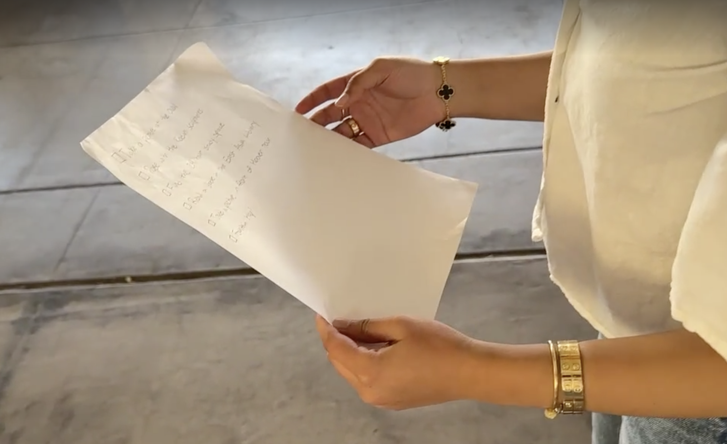
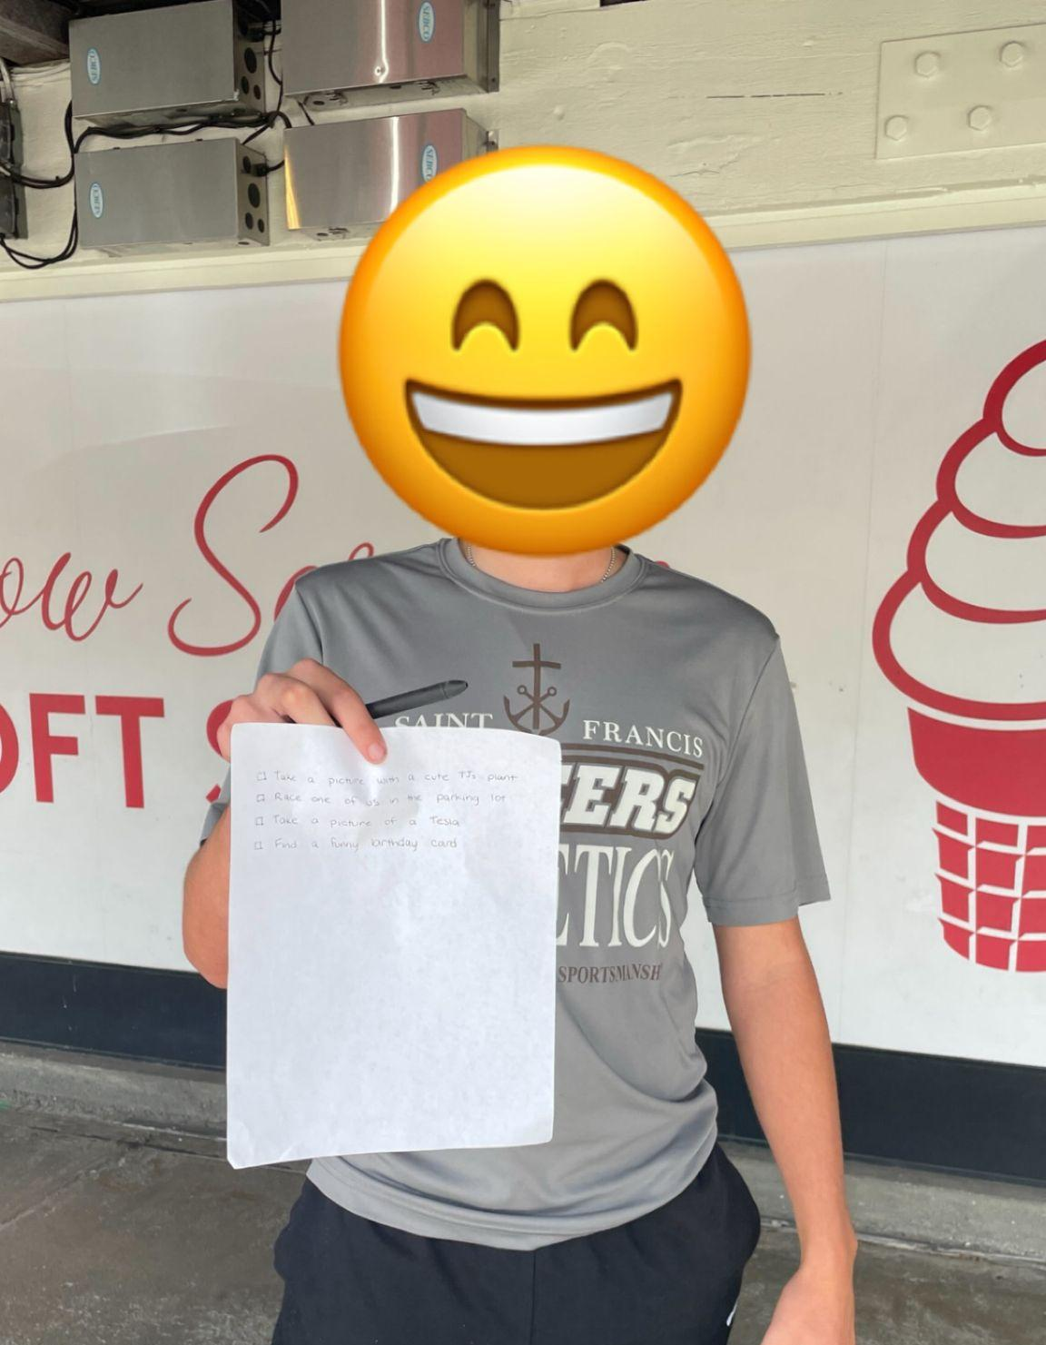

Slide 35
Prototype #1: Results
What Worked
Both participants completed the whole list!
Checking off items gave people a sense of accomplishment
What Didn’t Work
Too many items can be daunting
Inadequate resources can put people off
Learnings
People tend to tackle easier tasks first
The assumption was validated, so long as the list is manageable

Slide 36
Prototype #2: Background
Solution:
A platform for fostering deeper connections with your teachers so they can understand who you are and support you with more personalized recommendations, advocacy, and interactions
Assumption:
Students are comfortable reaching out to teachers for more than transactional conversations.

Slide 37
Prototype #2: Procedure
Task:
Ask each participant to think of a teacher they’d like to have a more in-depth conversation with. Ask them to draft an email to that teacher. Then, ask:
-What did writing that email feel like?
-On a scale of 1-10, how comfortable did you feel writing that email?
-Would you feel more comfortable if someone else was making the ask for you?
Participants:
Britney - a student looking for a coterm rec letter.
Joan - a high school student who had an underwhelming experience with a teacher.
Jack - a college freshman vaguely interested in research
Recruitment: T&C (high school), asking for contacts (Stanford)

Slide 38
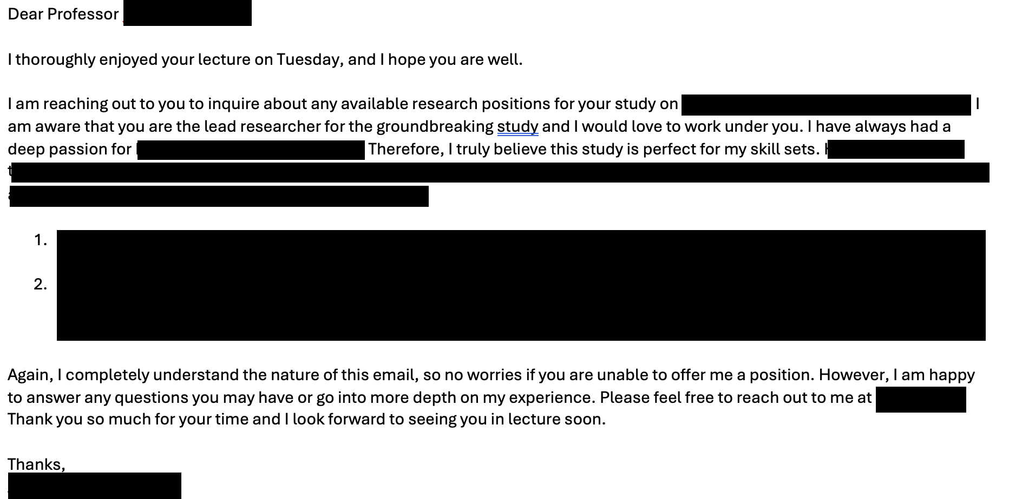
Notes:
Obtained permission from the interviewee to share this email, removing all identifying information.

Slide 39
Prototype #2: Results
What Didn’t Work
Reaching out to previous teachers felt “pointless”
Students were worried about big asks
What Worked
Students were willing to write the email
Average comfort was rated as a 6.7/10
Learnings
Students want to know someone wants to be contacted
Students like having outside support
The assumption was somewhat validated

Slide 40
Prototype #3: Background
Solution:
AI that goes through different students’ handwritten notes and highlights the major factual differences between them.
Assumption:
Students think it’s worthwhile to cross-reference their notes with others to check for inconsistencies

Slide 41
Prototype #3: Procedure
Task:
Dictate information for the participant to take notes with, knowing they will be quizzed. While they are reviewing their notes, ask them if they’d like to compare with other students’ notes. After the quiz, ask:
-Why did you (not) take the notes?
-[If taken] Did the additional notes affect your answers?
-What were you thinking while taking your own notes?
Participants:
Mack, a college freshman who exclusively handwrites notes.
Recruited via reaching out to frosh for contacts.

Slide 42
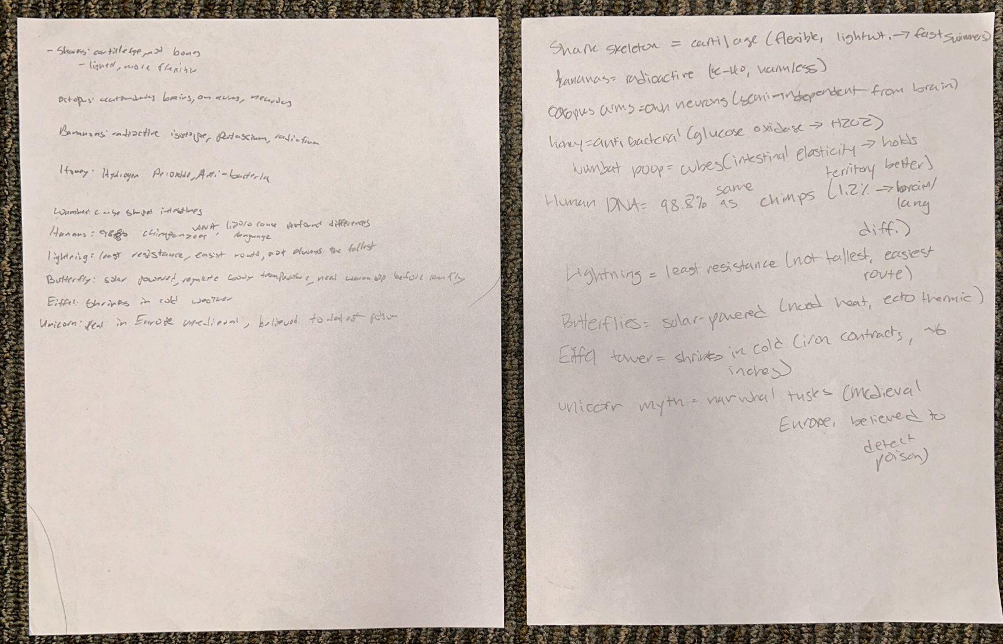
Notes:
Participant notes (left) vs the notes they were offered (right)

Slide 43
Prototype #3: Results
What Worked
The participant took the notes
The notes helped Mack with information he didn’t write down himself
What Didn’t Work
Mack still missed some answers
Not everyone feels comfortable sharing notes
Learnings
Students are willing to accept additional notes and find it useful
The assumption was validated overall
Handwriting is another concern for students

Slide 44
05
What’s Next?

Slide 45
What’s Next
Moving forward with solution 2: A platform for fostering deeper connections with your teachers so they can understand who you are and support you with more personalized recommendations, advocacy, and interactions.
Ethical Considerations
Increased interactions could lead to more interpersonal conflict.
This could place an additional burden on teachers who already have full schedules.
Better recommendations for all students could reduce the efficacy of letters for students who need letters to round out an academically weak holistic profile.
Our Solution Serves: High school students looking for community and support in a school that may comprise thousands of students.
Our Solution might leave out: Students with social anxiety or teachers with limited bandwidth.

Slide 46
06
Appendix

Slide 47
Ryder Empathy Map
Wants to take CS classes over the summer to get ahead
Not challenging classes are “bad” and challenging classes are “good”
Say
His chemistry notes are graded and have a specific expected structure
Think
Can’t afford to live in his hometown immediately post-grad from college
Cooking is an insecure career path
Has considered culinary school instead of college
Would want to work for michelin star restaurant if pursuing culinary
People who get into fights at school are “dumb”
Likes chatGPT but has noticed it can’t handle many prompts at once
Turns to mom for help with applications
His parents want/expect him to do well in school
School-provided tutoring is a waste of time
Taking harder classes is important for college apps
Taking notes are more for cognition that for recording since teachers share notes after class
B+ is a kinda bad grade and C is a “bad grade”
Playing water polo will help him get into college (aspiring college athlete)
Most important factor in choosing a college is the job you want post-grad
Has older friends to discuss college with
Feel very confident in answers from ChatGPT (compares it to Google accuracy)
Studying computer science will lead to financial security
Do
Has a shared doc with friends for taking notes in class
Switched into more academically rigorous classes 5 days into the term
Feel
Prefers to handwrite math notes because of equations
Learns water polo tricks by watching the olympics and YouTube
Peer pressured into taking AP and advanced classes
Inspired by recipes he finds or water polo he sees online
Safety in pursuing more academically rigorous paths
Joy in cooking
Let down and discouraged by recent quiz scores
Volunteers through the Young Men’s Service League
Starts smaller tasks first to get them off his plate
Takes note to aid memorization
Slightly overwhelmed by the population jump from middle to high school
(500 -> 1000)
Confident in study skills he has learned from previous private tutors
Checks Canvas at least once a day (usually at night)
Signed up for a private tutor after getting a bad math grade
Has chatGPT make him practice problems
Visited the school’s college counselor in middle school
Uncomfortable talking about fights in school
Motivated to do well by his parents’ expectations and personal pride
Relatively safe at school (as long as he acts “smart”)

Slide 48
Erica Empathy Map
If the story is good the scores matter less
Daughter is already community member
Writing / Storytelling ability are important
A solid story can help students with worse academics get into college
Say
English Teacher + Training & Money = College Counselor
Think
Relationships & Mentorship are very important
It takes time to craft your story
College Counseling isn’t about judging a student’s readiness
It’s not about admission; it’s about continued mentorship
College counseling needs a personal touch
“It’s all about social capital”
Colleges would say readiness = GPA/SAT
Finding female PhD mentors was a critical piece for her
There are new resources but never enough
Non-holistic applications leave people out and are incomplete picture
SACAC NACAC Teach for America do good work
High Achievers are stubborn; hardest to work with
Students might look down on her background
It’s hard to succeed without support from mentors/adults
Dr. Parker + Dr. Bremmer Female PhDs her mentors / champions
Easy to ignore her comments on Google Docs
There are untapped resources in school
Do
Worked in admissions at alma mater; fell in love with it
Worked for uni as “holdover” while studying for LSAT, but fell in love w/ admissions
Gains the respect of students through useful feedback and not giving in
Feel
Wrote a powerful letter that was the reason a student got into their university
Empathy / Deep care for students
COMM is relevant to her role
Empowered by mentors’ support and encouragement
Responsible for advocating for her students
Pride for her impact as an advisor
Reads, or encourages students to read, aloud to notice more
Wrote dissertation on why SATs capture a moment and not resilience of learning
Sat with student 1 hr/wk for Stanford app
Coasted through high school as an avg student
Frustrated by high achievers resistance to her help
Empathy for students who don’t have the support they need
Mount Vernon is a good place to go to school
Her purpose is getting to know and supporting her students
Inspired by the math teacher who switched to college counseling
Switched from Comm minor to majors thanks to professor guidance
Wasn’t good at science/math => concluded she was mediocre
Sends her daughter to school she works at

Slide 49
Sue Empathy Map
It is hard to collaborate with the school
“There’s a lot higher stakes earlier on”
”I don’t think [teachers] understand AI’s influence.”
It’s very important that the support that isn’t coming from the parent is also effective
Say
”I’m a first gen kid, a person, and, you know…my parents were immigrants.”
Think
There are barriers for first-gen students that other students don’t face
AI unfairly benefits some kids
Some kids will pay services to make non-profits and list the kid as the founder
Wants success for her kids
Has 2 kids
“We talk about intelligences differently.”
“I want [my kid] to do it, you know…I really don’t want her to be so college focused.”
Not all application look/should look the same
Schools could improve the way they keep parents in the loop.
Getting into college has turned into a game; the rich/connected win
Awards are good standardized indicators of success
College admissions officers don’t know how to interpret FLI applications
“Some [kids] want to [take notes] the old fashioned way.”
“It doesn’t read…as fantastically when a first gen, low income kid is running their parents business.”
“College is so expensive.”
It might be difficult for a student to realize what they really want vs. what colleges want them to be.
“I’m not there, and they’re supposed to check in on her.”
Do
Let’s her kids come to her when they’re ready to talk about something
Left college admissions to work in education consulting
Tries to get into contact with her kids’ teacher about her 504 plan
Feel
Worked while she was a student to pay for school
Worried about her kids overworking
Proud of her oldest kid
Baffled by how selective colleges are these days
Impostor syndrome about her own background
Frustrated with the school admin
Engages with her kids’ classes/ activities as much as they want
Worked at a nonprofit foundation to help kids with scholarships
Doesn’t focus on grades with her kids
Try to prove herself in her job
Cautious about how AI affects kids
Cautious about letting school take over “checking-in” on kids
Willing to share/draw upon her personal story when helping others
Called to support kids who need extra help
Empathy for students who have to work extra hard
Advocates for FLI kids in college admissions
Worked as an admissions officer without a fancy education
Work with her kids’ schools on LGBTQIA+ issues

Slide 50
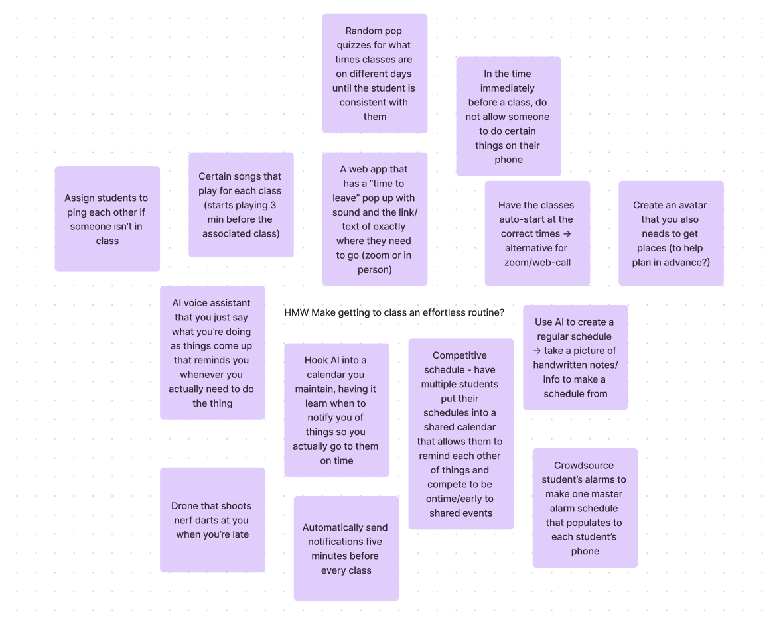
Solution Brainstorming Screenshots

Slide 51
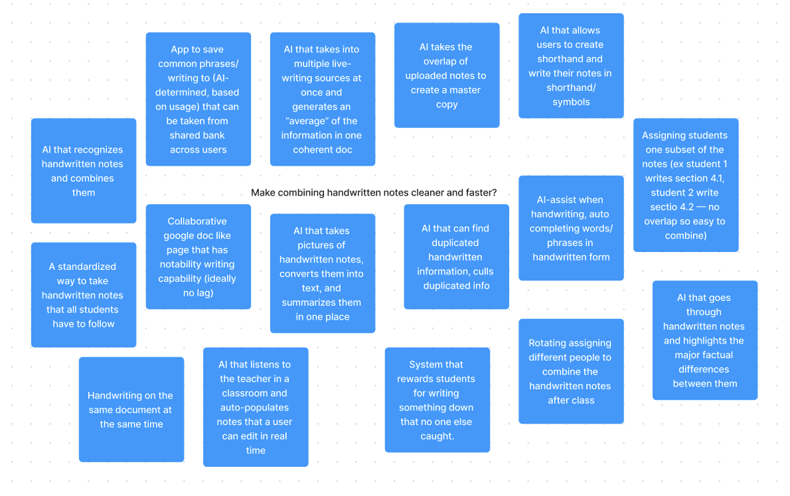
Solution Brainstorming Screenshots Cont.

Slide 52
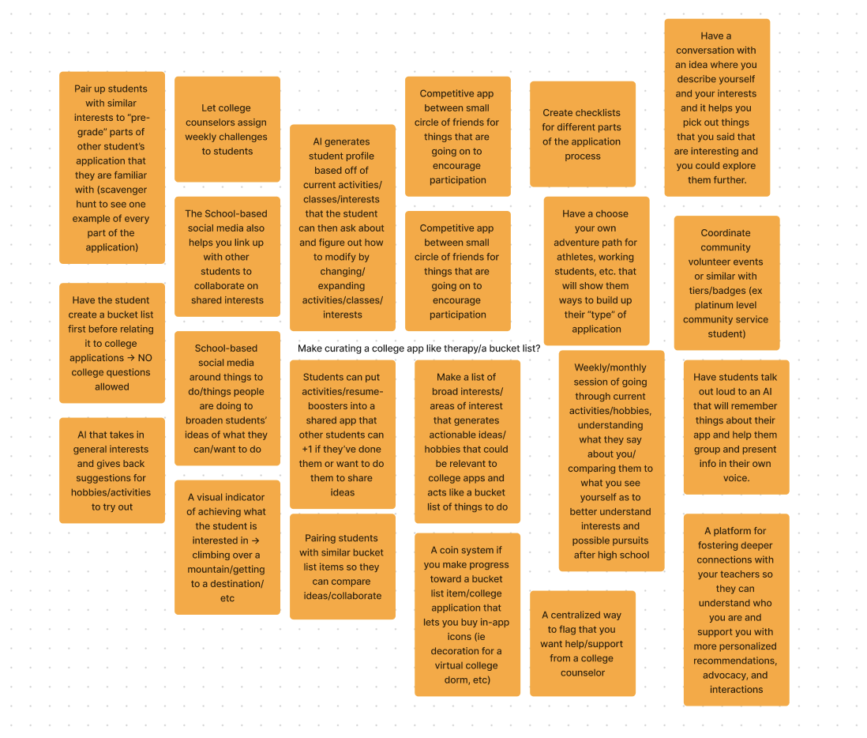
Solution Brainstorming Screenshots Cont.

